Slide 1
Measuring Stellar Abundances
Raihan Malik, Seth Ketchem
Group 8

Slide 2
Motivation
Understand:
Curve of growth method
How stellar abundance is properly measured
Boltzman & Saha equations + application
Report results in ways that physicists / astronomers do/

Slide 3
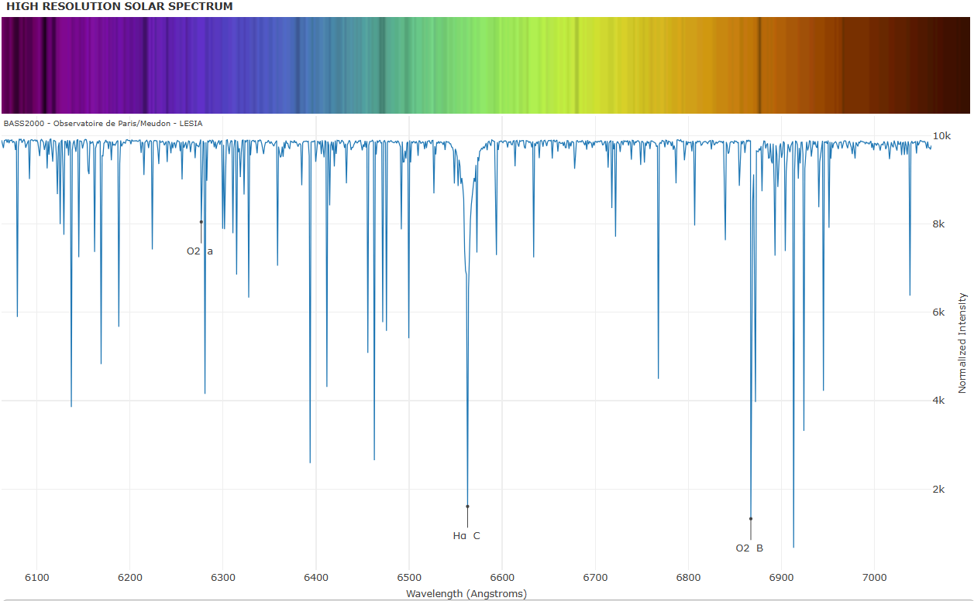
Spectroscopic Data

Slide 4
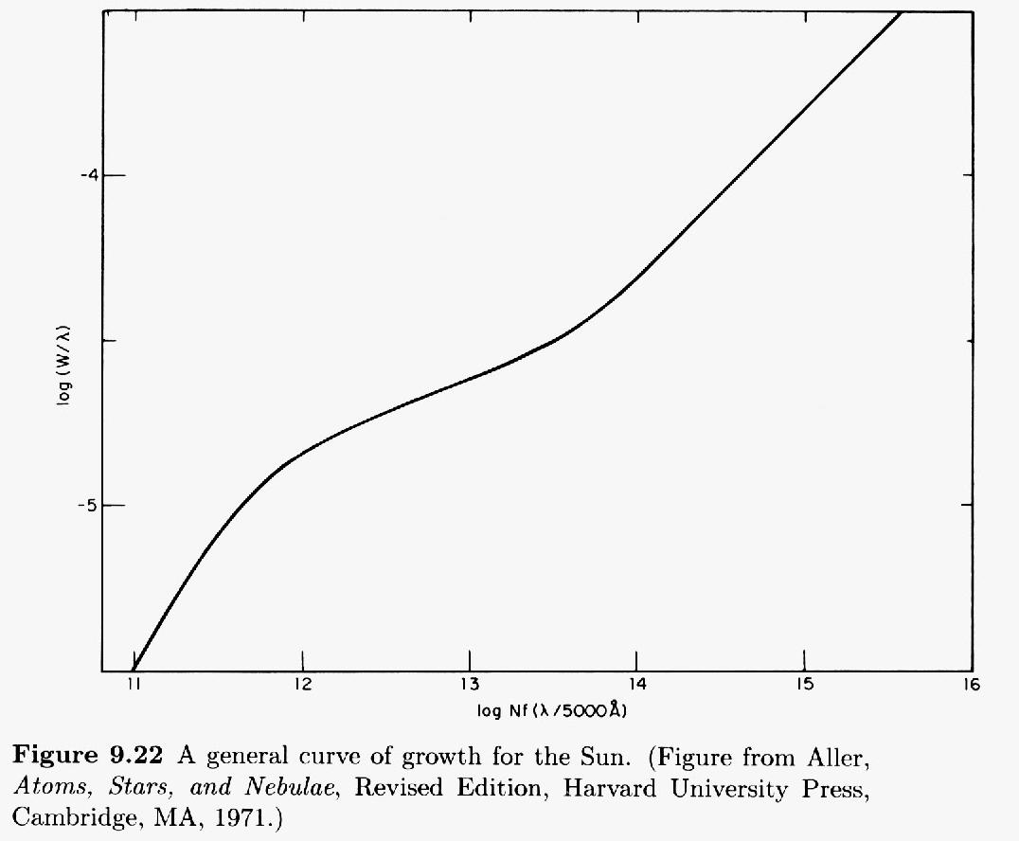
Curve of Growth

Slide 5



Boltzmann
Saha
N₂ = N_{3p}, N₁ = N_{3s}

Slide 6
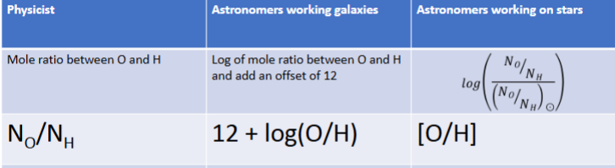

Slide 7
Results
N = 8.24 x 10¹⁴ (from curve of growth)
N₂/N₁ = 0.0434 (from Boltzmann)
N_{aII}/N_{aI} = 2477.66 (from Saha)
Column Density = 2.13 x 10¹⁸

Slide 8
3.23 x 10⁻⁶
6.51
0.209

Slide 9
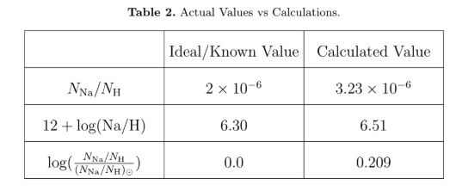
Conclusion
Our measurement and calculations for the NA abundance are consistent with known values
Error from a combination of factors:
Assumption of oscillator strength
Estimate from the curve of growth
Calculation of equivalent width.

Slide 10
Questions?
Division of Work
Coding - Raihan Malik, Seth Ketchem
Paper - Seth Ketchem
Presentation - Raihan

